Slide 1
Emojinator Recognition and Prediction
Xiangbei Chen, Song Luo, Ming Lyu, Chen Yin

Slide 2
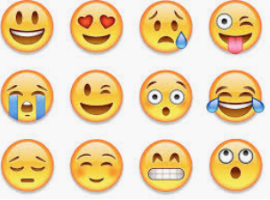
Introduction
Applications
Image Recognition
Object Detection
Natural Language Translation
Trend Prediction
Not Typographic but Emoji
Real-time Image Recognition
CNN and VGG16
Live Demo
Notes:
Deep learning is a hot topic now
Emoji is a visual symbol widely used in wireless communication. It includes faces, hand gestures, animals, human figures, and signs. Instead of typographic, emoji are actual pictures. As there is increasing use of emojis, the needs for instant generation of emojis have become urgent.

Slide 3
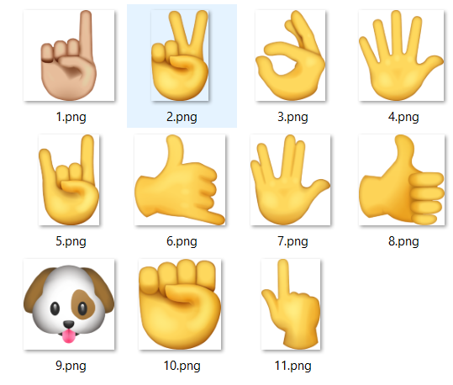
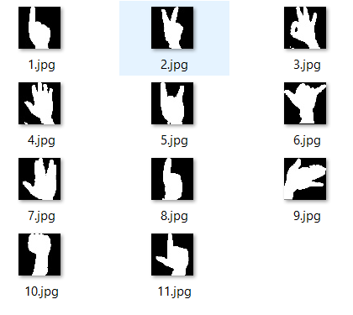
Dataset
11 Groups
1200 images for Each Group
Pixel Style
Real-time Capturing
Notes:
Cxb
Our dataset is from the project on GitHub[1], which contains the training images and target emojis. In this project, we want to train our model to make it able to recognize the eleven emojis, and the sample of target (output) images and training images are shown in Figure 1 and Figure 2. For each of the emoji, there are 1,200 corresponding pixel style training images that make sure our training set is balanced. After the training process, we use a webcam to capture real-time hand gestures and process it to the pixel style images and make real-time predictions.

Slide 4
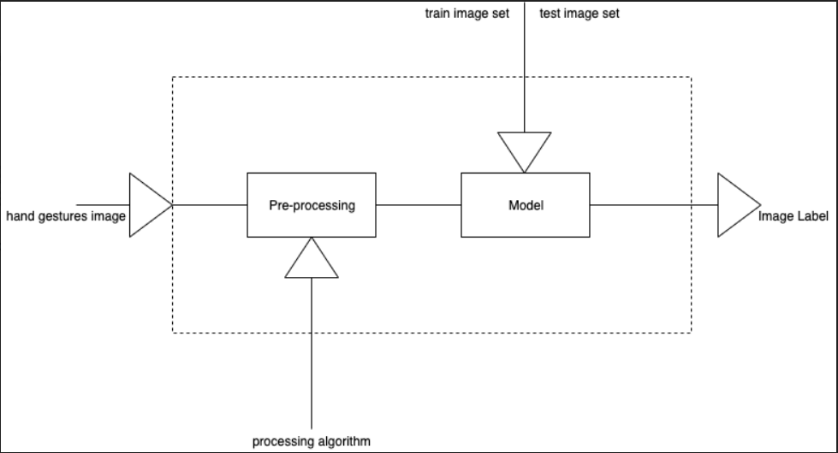
Workflow
Notes:
yc

Slide 5
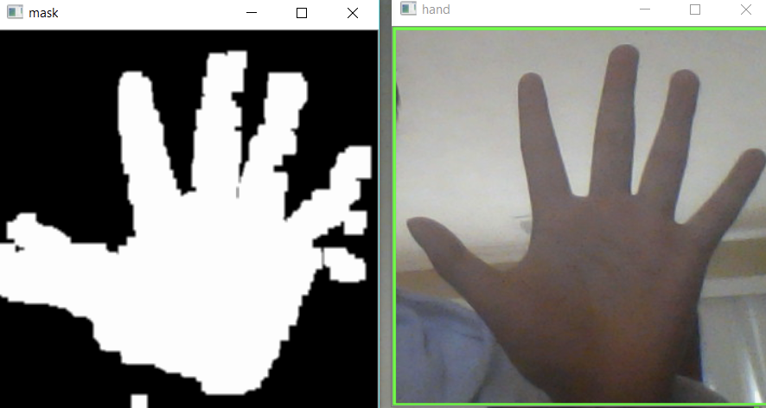
Morphology Operation
Resize
Skin color range
Erode
Dilate
Gaussian Blur
Notes:
Erosion/dilatation are two basic operators in the area of mathematical morphology, the other being dilation.
The basic effect of the operator on a binary image is to erode away the boundaries of regions of foreground pixels (i.e. white pixels, typically). Thus areas of foreground pixels shrink in size, and holes within those areas become larger. we could not promise that if the background was clear enough to make hand gestures ready to be modelled. We wanted first to ensure that the shape of the hand was correct, so we choose to erode it first.
The basic effect of the operator on a binary image is to gradually enlarge the boundaries of regions of foreground pixels (i.e. white pixels, typically). Thus areas of foreground pixels grow in size while holes within those regions become smaller.
Dilate = 呆late

Slide 6


Data Augmentation
Horizontal_Flip
Horizontal/Vertical Shift
Rotation 10°
Combine multiple iterations
Size/Shape limitation
Notes:
Sometimes our model fails to recognize the gestures. So we chose to improve this from the training stage by applying some DA strategies.
Our original dataset contains only left-hand gestures. So we used the horizontal_flip to includes the corresponding right hand gestures. Sometimes we cannot put our hand just at the center of the detected area, so we use horizontal and vertical shift and we think setting rotation range to 10 degree makes sense.
One thing to notice about is that we find a easy way to enrich the dataset, which is including multiple random outputs by a single datagenerator.
These two gestures are the ones always fail. And we later find that it is because the testing sample differs from the training dataset. By that I mean we have different shapes of hands, for example people have different range between forefinger and ring finger and out model fails to recognize when the testing gestures differs too much from our training dataset. That’s one problem we still facing and maybe the simplest way to improve that is just collecting more dataset rather than using some fancy data augmentation strategy.

Slide 7
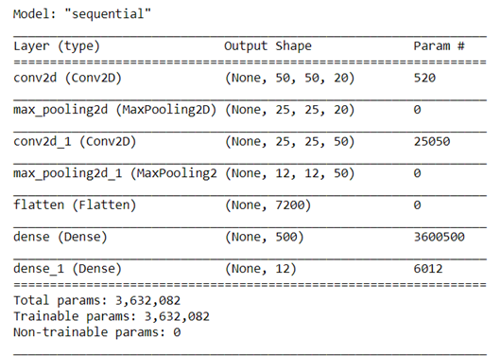
Convolutional Neural Network
Learning Rate: 0.01
Batch Size: 1000
Notes:
Lm
We use LeNet model as our base training model. Our final model has two sets of convolutional layers, relu layers and softmax layers. After that, we have a flatten layers, a fully connected layer and a softmax layer to get the classification output label. We have tried to use three sets or four sets of layers but it does not improve much on the training and validation accuracy since they are all close 1. Therefore, we decide to use two sets of these layers,which is the traditional layout of the LeNet.

Slide 8
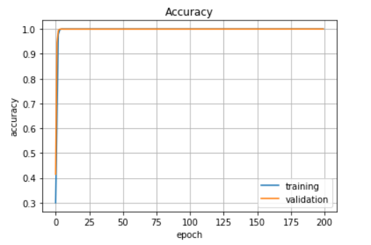
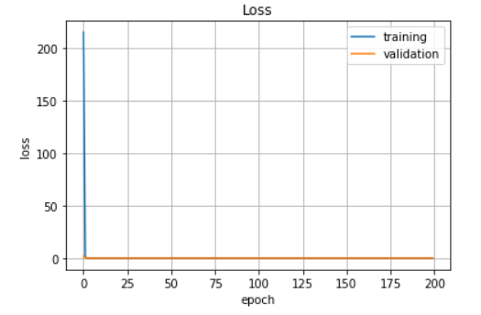
Results
Baseline: VGG16 - Training Acc: 0.99
Testing Acc: 0.98
Notes:
lm
These are the learning curves of our model. We can see that the training and validation accuracy increases to 1 rapidly at early stages of the training iterations. The training and validation loss converges to 0 at early stages of the training iterations as well. It indicates that our model has a good performance on recognizing gestures from static images. However, the performance is not stable when classifying real-time input frames. We will present a short live demo on our project.

Slide 9
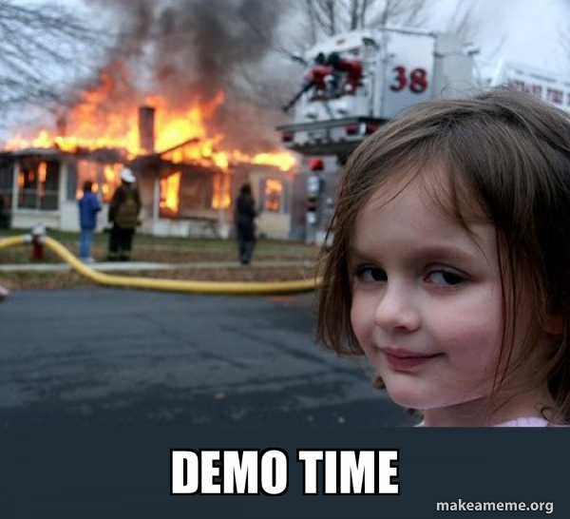
Demo
Notes:
lm

Slide 10
Conclusion
Future Improvements
Light Settings
Images Resolution
Multi Perspective View Input
Notes:
cxb

Slide 11
Thanks for Listening
Q&A

